Slide 1

CS302 Design and Analysis of Algorithms
Muhammad sohail afzal

Slide 2
Cook’s Theorem
We need to have at-least one NP-Complete problem to keep the ball rolling.
Stephen Cook showed that such problem exists.
He said “SAT Problem (Boolean Satisfiability Problem) is NP-complete problem”. This is Cook’s theorem and he used turing machines in early 70’s and proved that SAT problem is NP-complete problem

Slide 3
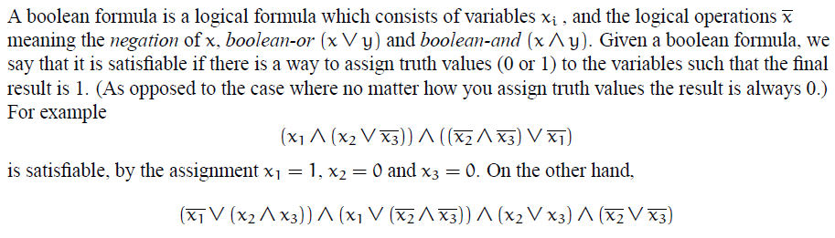
Cook’s Theorem
SAT problem is stated as follows:

Slide 4
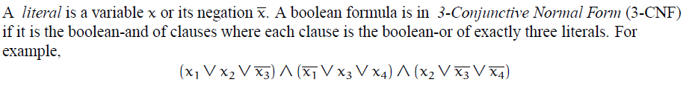
Cook’s Theorem
Even a more reduced version of SAT problem is also NP-complete. 3CNF is reduced form of SAT problem and it is also NP-complete
Above expression is 3CNF SAT form where is one clause that has three literals. So above expression has 3 clauses with 3 literals in each. As each clause is separated by “And operation” so answer to this complete expression will evaluate to true if each clause will evaluate to true.

Slide 5
Reduction Example 2: Reducing 3CNF SAT to Clique decision problem
In previous lecture, we have seen reduction of 3 graph coloring problem to Clique cover problem which is reduction example 1.
Here we will be reducing 3CNF problem to clique problem (clique decision problem) to show that clique decision problem is also NP-Complete problem.
Please note that clique problem(clique decision problem) is different from clique cover problem that we studied previously.

Slide 6
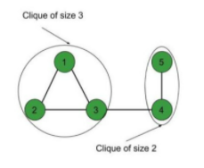
Reduction Example 2: Reducing 3CNF SAT to Clique decision problem
Clique decision problem
In clique decision problem, we have to find whether there exists clique of size “k”. Clique of size “k” means if there exists “k” number of vertices that are making a clique (complete sub-graph)
Like if k=3 then we need to find if there exists 3 number of vertices that are making a clique(complete sub-graph). So for below graph it is YES as it has vertices 1,2 and 3 that are making clique.
Please note that clique problem(clique decision problem) is different from clique cover problem. We saw in previous lecture in clique cover problem that “k” is total number of cliques. But in clique problem(clique decision problem), k is total number of vertices that are making a clique.

Slide 7

Reduction Example 2: Reducing 3CNF SAT to Clique decision problem
For example, you want to reduce this expression of 3CNF to clique decision problem :
Where means (negation of x1).
So steps to follow while reducing 3CNF to clique decision problem:
For each clause, create a vertex for each literal
For the edges, connect vertices if they come from different clauses (do not connect vertices in same clause)
No vertex (literal) should be connected to its negation in other clause.

Slide 8
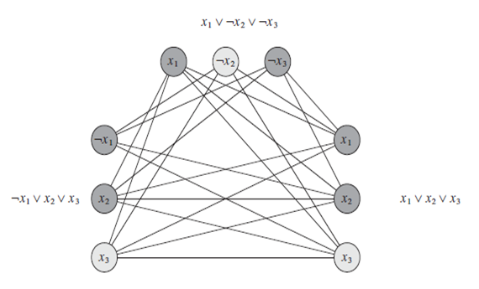
Reduction Example 2: Reducing 3CNF SAT to Clique decision problem
The final graph will look like this :
If k=3 then in above graph we have clique of size 3.

Slide 9
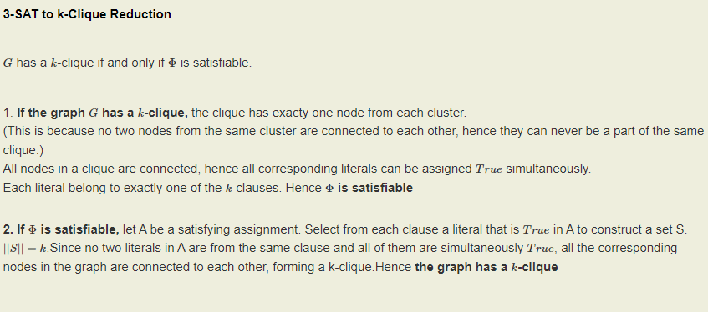
Reduction Example 2: Reducing 3CNF SAT to Clique decision problem

Slide 10
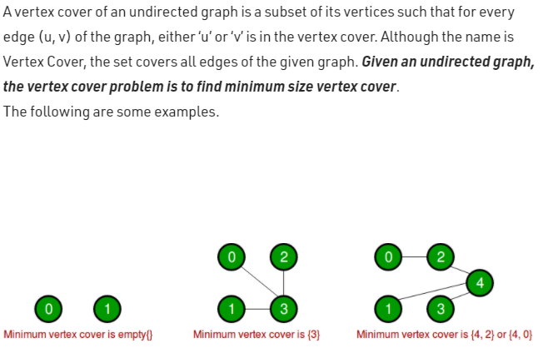
Reduction Example 3: Reducing clique decision problem to vertex cover
Vertex Cover Problem :

Slide 11
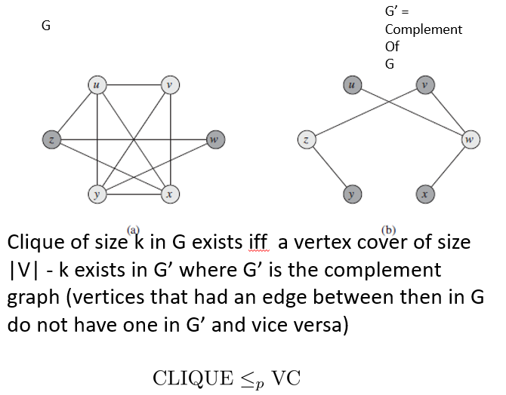
Reduction Example 3: Reducing clique decision problem to vertex cover

Slide 12
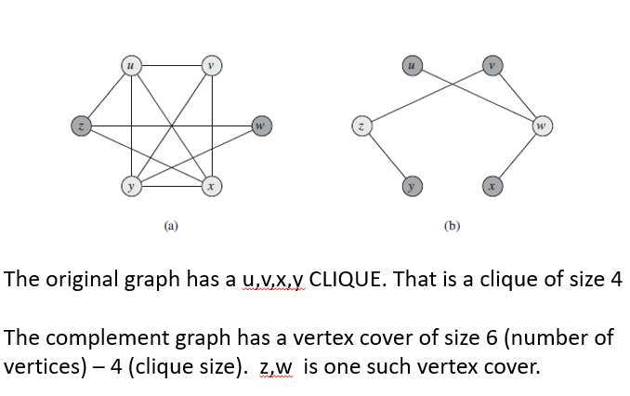
Reduction Example 3: Reducing clique decision problem to vertex cover

